Slide 1

Team Participants
Faustina O.
Ibiyemisi G.
Angela B.

Slide 2

Our Goals
Bring attention to the skills needed for jobs
Connect users with resources to learn new skills
Simplify the job application process

Slide 3
How did we reach this idea?
Applying to jobs is a job
Learning new technical skills isn’t restricted to the classroom
Lack of people of color and women in tech
Promote free and easy ways of learning technical skills
Bridge achievement gap for underrepresented minorities
Bridge achievement gap for low-income persons

Slide 4
How does it work?

Slide 5


First, we need your skills!
Login via LinkedIn or Submit your Resume

Slide 6


Locate your Dream Job
There are 2 ways:
Search for a job
Give us a link for a job you found

Slide 7

Now, the magic begins.
Resume Evaluator
Highlights technical skills in job postings
Notifies user of skills needed for a strong application

Slide 8
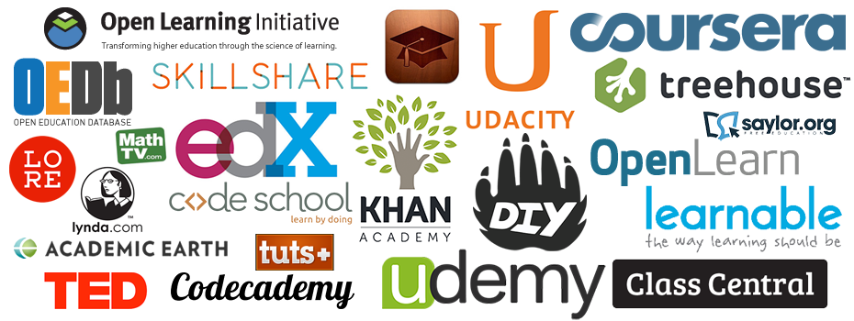
Finally! Resources.
Free or easy to use resources to obtain each skill!

Slide 9
Machine Learning
How to apply:

Slide 10
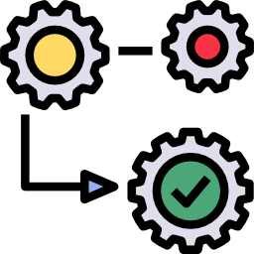
Classifying Text
Supervised Machine Learning
Dictionary of words that are technical skills (Train)
Labels words in descriptions and resumes as “skills” (Predict)

Slide 11
Google Cloud Platform
Ways to utilize:

Slide 12
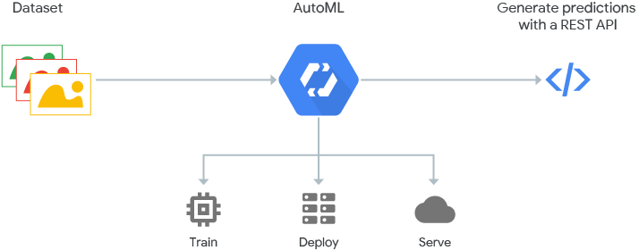
Google Cloud Platform
Cloud AutoML
Train and test data using text from 1000s of job descriptions
Predict classification of text based on our fitted model

Slide 13
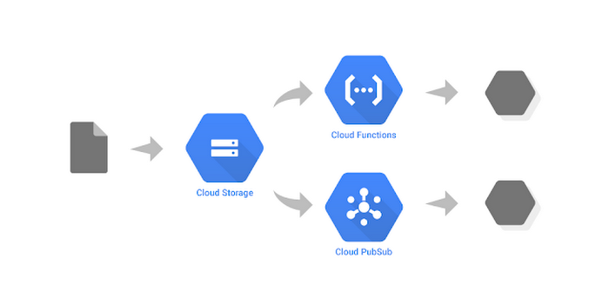
Google Cloud Platform
Google Cloud Storage
Online file storage for accessing data
Access data needed for Google Cloud Platform Infrastructure

Slide 14

Google Cloud Platform
Benefits:
Runs on the same server as Google apps
Google client library simplifies Python
Includes the same great features and speed

Slide 15
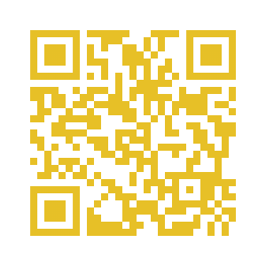
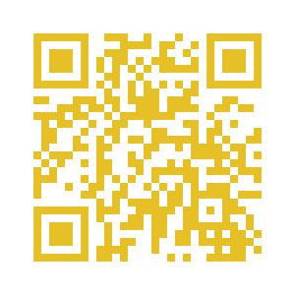
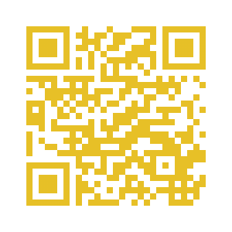
Thank you!
Faustina Owusu
1st Time Hacker
Sophomore, CS Major
Connect with me on LinkedIn
Angela Bonsol
1st Time Hacker
Sophomore, CS Major
Connect with me on LinkedIn
Ibiyemisi Gbenebor
1st Time Hacker
Senior, Data Science Major
Connect with me on LinkedIn

